Slide 1

Silicon Alchemists
Team Members
Yatanvesh Bharadwaj
Yash
Navaneeth V
Abhrajyoti Pal

Slide 2
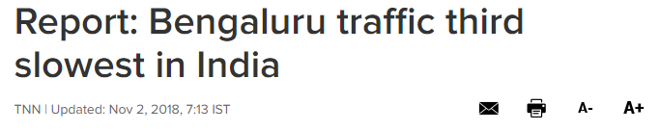
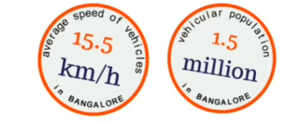
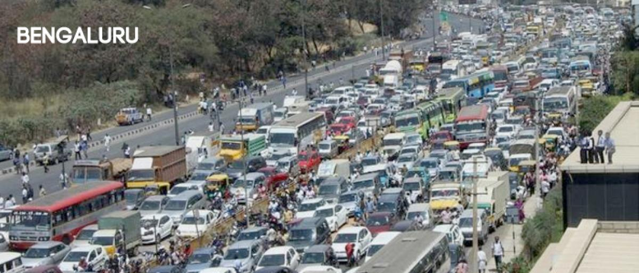
The Problem
Source: Times of India
The traffic situation in Bengaluru is inevitably a matter of trouble for its commuters. A city with such thriving population needs state-of-the-art Technology to attend to its high infrastructure needs.
Bangalore is a city where u use the term “shortcut” to denote time and not distance.
#BangaloreTransit
180 secs is the amount of time I spend in one traffic signal.
#BangaloreTransit

Slide 3

Our Solution
RoadRunner
presents
Traffic Control
(Powered by Artificial Intelligence)
Boris Kerner's Three-phase traffic theory, developed between 1996 and 2002, concludes that, there is a direct correlation between flow rate of vehicles and density of vehicles. This relation terminates at a maximum value of flow rate.
The proposed system aims to minimize waiting times for motorized vehicles in traffic junctions. The model takes Queue Lengths and Average Speeds of vehicles in different lanes corresponding to a junction as input and provides the traffic light configuration for the junction as output.

Slide 4
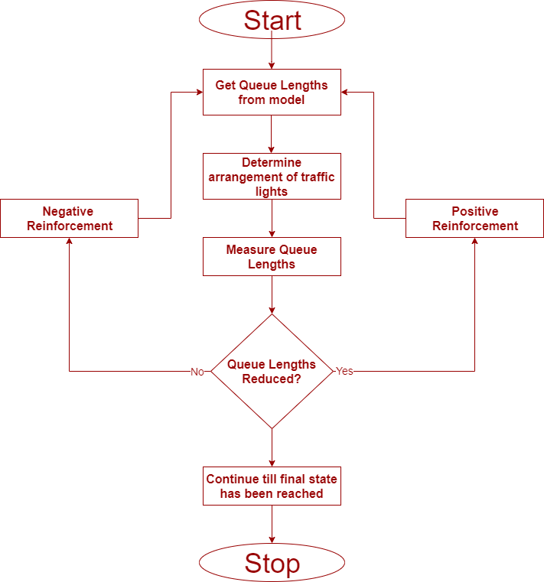
Our Approach
Algorithm
Q – Learning
(Reinforcement Learning)
Deep – Q – Learning Approaches
Minimize Queue Length
(Works for bridges/long stretches of roads)
Maximize Average Speed
(Works for small congestion at junctions)

Slide 5
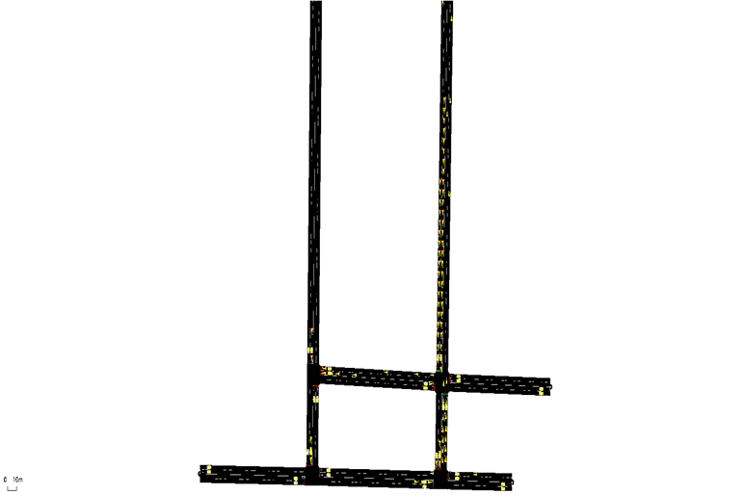
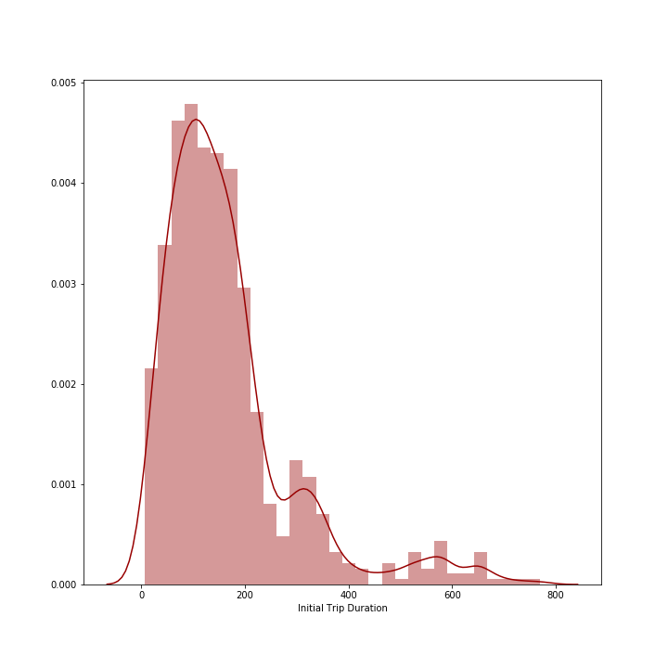
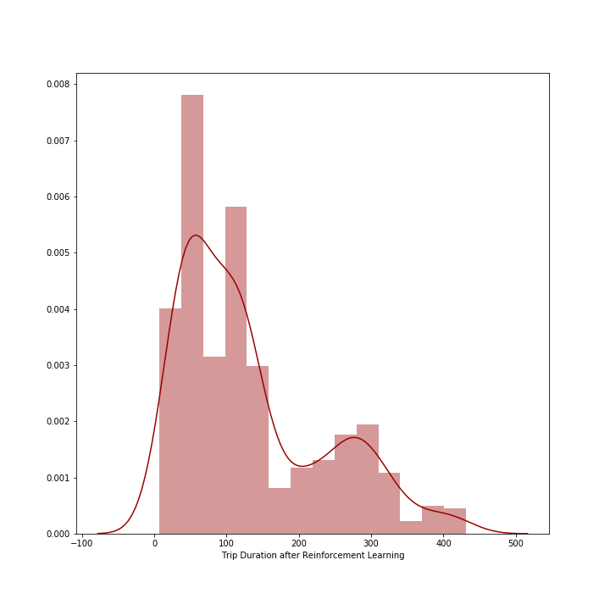
Our Approach
Maximum Trip Duration reduced from 750 – 800 units to 400 – 450 units.
Mean Trip Duration reduced by 20 – 25 %.
Median Trip Duration reduced from 135 to 106 units.

Slide 6
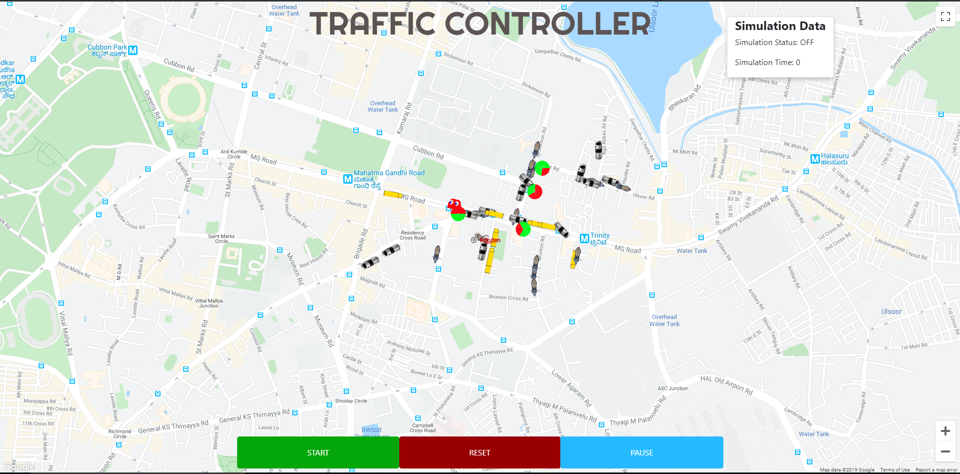
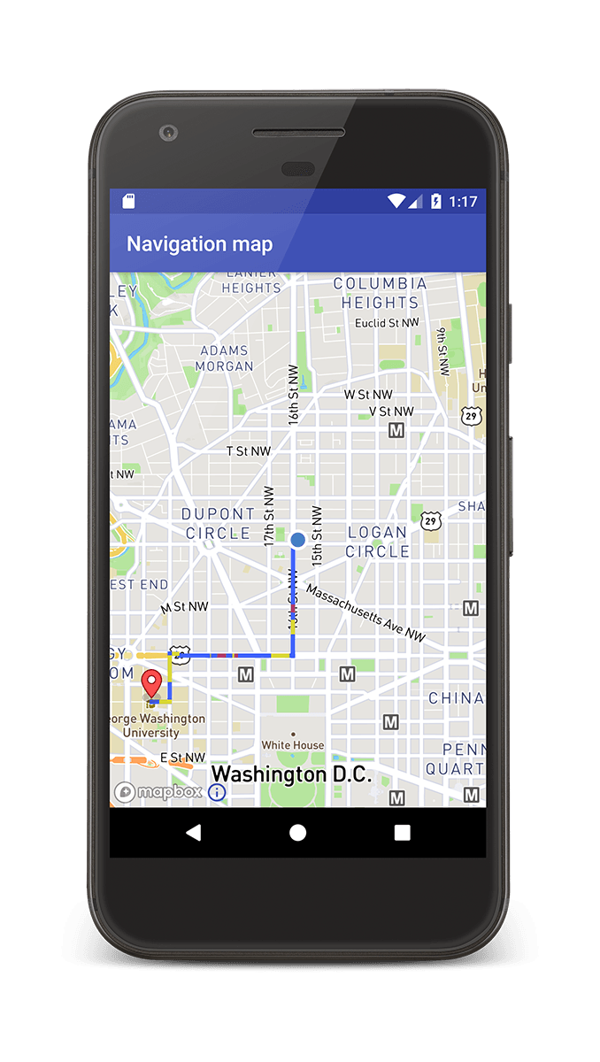
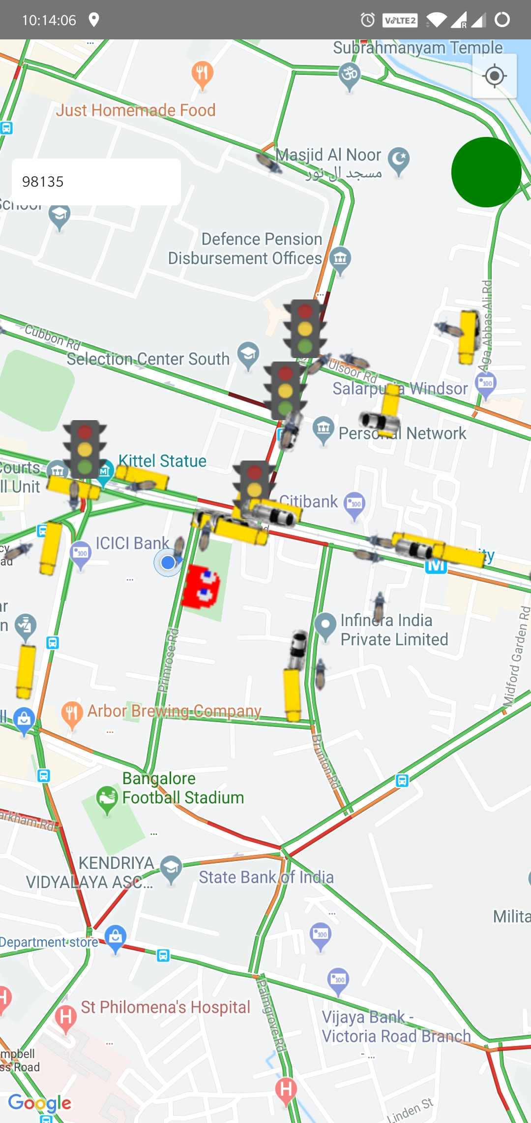
Our Approach
Smartphone App Module:
Intuitive App built on Google Maps.
Allows the user to crowdsource their location data.
The user is given the knowledge of the signal status at the upcoming junction.
The app prompts the user to adjust their speed so that they arrive during a green light.
Web App Module:
Centralized Controller of simulation based on Google Maps for monitoring the system.

Slide 7






Tech Stack and APIs Used
Backend
Web App
Mobile App
Simulation
Artificial Intelligence

Slide 8

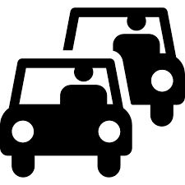



Advantages:
Accuracy
(Accurately determines vehicle movements on map)
Adaptable
(Can adapt to any occasion given data is available)
Traffic Light Icon
(App shows accurate status of upcoming traffic signal)
Intuitive
(Built on top of widely used Google Maps interface)
Easy Transit
(Decreases downtime of emergency services)

Slide 9
Thank You

